Slide 1
ONE HYMN IN IS ‘NOT CORRECT’
“m[nuK kY ikCu n[hI h[iQ~.– a human being cannot do anything.

Slide 2
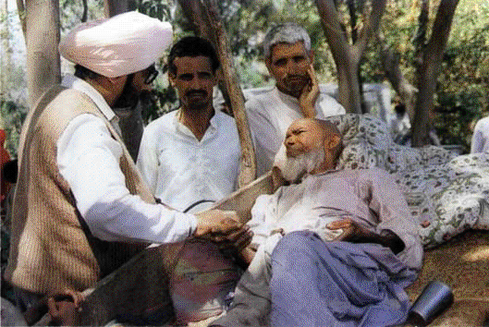
I could not believe my ears when a medical doctor at a Sikh Youth camp in USA told me, "There is one line in Sukhmani which is not correct."
Before I could think of any response, he continued, “– a human being cannot do anything.
You know I treat sick persons and make them healthy.”

Slide 3
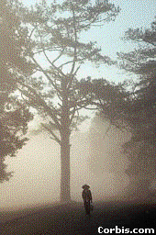
For this unusual question, I started with an unusual approach.
I asked the doctor, "How can you make sick people healthy? I don’t think you can even walk to touch that tree which is only 9 to 10 feet away."
It was the month of July and we were sitting under the shade of a grove and eating apples.
The doctor took a couple of steps, touched the tree and said, "See ! I have done it."

Slide 4

What I was to say was already in my mind, "No. You were taken there by God. Did you not breathe air provided by God for you to remain alive and walk?“
He did not expect that response from me.
While sitting on the chair, he said, "This is nature. It is already here.‘
The tone of his words revealed that he understood my message.
I continued, "We can do nothing.
Everything is in the hands of God."

Slide 5
Body is a gift of God
Who are we? We were born from a speck.
After being fed, first the milk of the mother and later food of many kinds, we became adults.
All these things were provided to us by God.
The apple and other fruit, are produced for us by God.
No human being can create a single fruit or grain.
Our body is, thus, a gift of God and it depends upon His blessings all the time.
Our soul,, is a reflection of God because of which we are alive.

Slide 6
Intellect is gift of God
The physical, intellectual and other faculties are provided to us by God.
You, as a doctor, know that human beings have their own individual nature and thinking.
Who gives them this thinking and mental faculties?
The best students join the medical profession but some of them fail to perform the hard work.

Slide 7
God is running this whole show.
Even though they wish it, they are not provided with the devotion, intellect or other characteristics necessary to complete the requirements of the medical degree.
God is running this whole show.
We are mere actors who have been assigned our separate roles to perform according to our capabilities.
God is Kartar.
He runs the whole show

